Slide 1
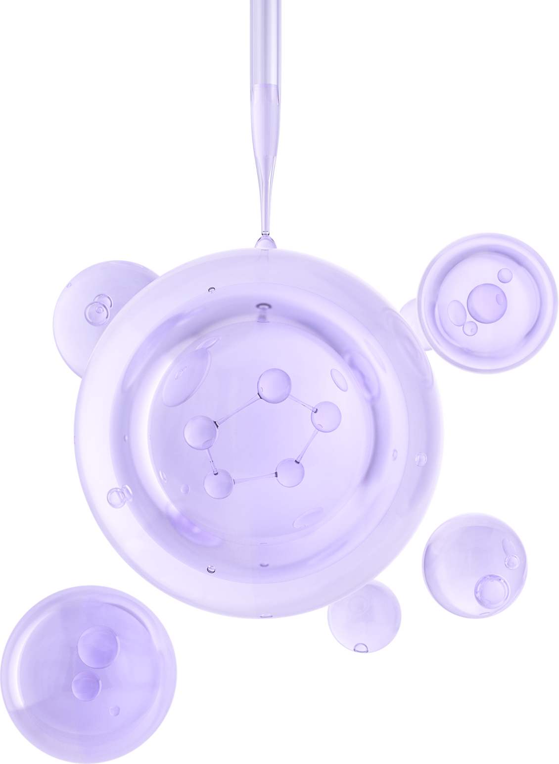

UNIVERSITY OF BASRAH / COLLEGE OF SCIENCE
LECTURE PhD. 6
Enzymes
Department of Biology
Prof.Dr. Saad S. Mahdi Al-Amara

Slide 2
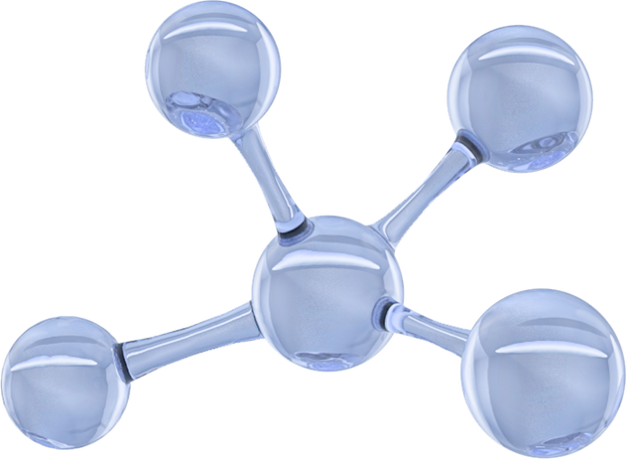
Transfer Reactions by Enzymes Other enzyme-driven
processes that involve the simple addition or removal of a functional group are important to the overall economy of the cell.
Oxidation-reduction and other transfer activities are examples of these types of reactions.
Some atoms and compounds readily give or receive electrons and participate in oxidation (the loss of electrons) or reduction (the gain of electrons).
The compound that loses the electrons is oxidized, and the compound that receives the electrons is reduced.
Important components of cellular redox reactions are oxidoreductases, which remove electrons from one substrate and add them to another.
Coenzyme carriers are nicotinamide adenine dinucleotide (NAD) and ﬂavin
adenine dinucleotide (FAD).

Slide 3
Other enzymes play a role in the molecular conversions necessary for the economical use of nutrients by directing the transfer of functional groups from one molecule to
another.
For example, aminotransferases convert one type of amino acid to another by transferring an amino group; phosphotransferases participate in the transfer of phosphate groups and are involved in energy transfer;methyltransferases move a methyl (CH3) group from substrate to substrate; and decarboxylases (also called carboxylases) catalyze the removal of carbon dioxide from organic acids in several
metabolic pathways.
The Role of Microbial Enzymes in Disease
Many pathogens secrete unique exoenzymes that help them avoid host defenses or promote their multiplication in tissues.

Slide 4
Because these enzymes contribute to pathogenicity, they are referred to as virulence factors, or toxins in some cases. Streptococcus pyogenes (a cause of throat and skin infections) produces a streptokinase that digests blood clots and apparently assists in invasion of wounds.
Pseudomonas aeruginosa, a respiratory and skin pathogen, produces elastase and collagenase, which digest elastin and collagen, two proteins found in connective tissue.
These increase the severity of certain lung diseases and burn infections.
Clostridium perfringens, an agent of gas gangrene,synthesizes lecithinase C, A , lipase that profoundly damages cell membranes and accounts for the tissue death associatedwith this disease.
Not all microbial enzymes digest tissues;some, such as penicillinase, inactivate penicillin and there by protect a microbe from its effects.

Slide 5
The Sensitivity of Enzymes to Their Environment
The activity of an enzyme is highly inﬂuenced by the cell’s environment. In general, enzymes operate only under the natural temperature, pH, and osmotic pressure of an organism’s habitat.
Low temperatures inhibit catalysis, and high temperatures denature .
Denaturation is a process by which the weak bonds that collectively maintain the native shape of the apoenzyme are broken.
This disruption causes extreme distortion of the enzyme’s shape and prevents the substrate from attaching to the active site.
Such nonfunctional enzymes block metabolic reactions and thereby can lead to cell death. Low or high pH or certain chemicals (heavy metals, alcohol) are also denaturing agents

Slide 6
Metabolic Pathways
Metabolic reactions rarely consist of a single action or step. More often, they occur in a multistep series or pathway, witheach step catalyzed by an enzyme.
An individual reaction is shown in various ways, depending on the purpose at hand
(figure 2.8) .
Many pathways have branches that provide alternate methods for nutrient processing. Others take a cyclic form, in which the starting molecule is regenerated to initiate another turn of the cycle.
Enzymes respond to various control signals and, in so doing, determine whether a
pathway proceeds. Regulation of pacemaker enzymes proceeds on two fundamental levels.
Either the enzyme itself is directly inhibited or activated, or the amount of the enzyme in the system is altered (decreased or increased).

Slide 7
Direct Controls on the Action of Enzymes
The bacterial cell has many ways of directly inﬂuencing the activity of its enzymes. It can inhibit enzyme activity by supplying a molecule that resembles the enzyme’s normal substrate.
The “mimic” can then occupy the enzyme’s active site, preventing the actual substrate from binding there.
Because the mimic cannot actually be acted on by the enzyme or function in the way the product would have, the enzyme is effectively shut down.
This form of inhibition is called competitive inhibition, because the mimic is competing with the substrate for the binding site (figure 2.9).

Slide 8
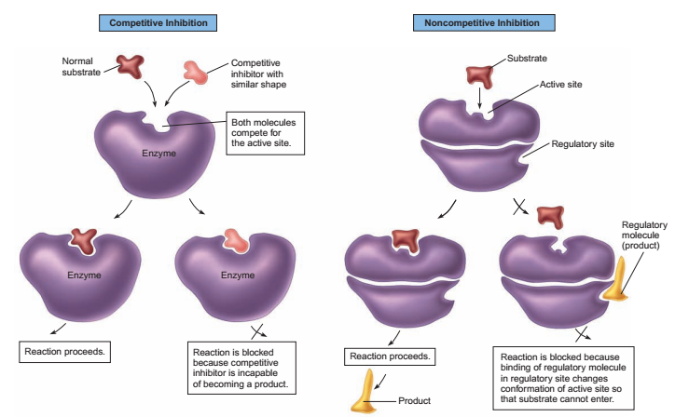
Figure 2.9 Examples of two common control mechanisms for enzymes.

Slide 9
Strategy of competing with enzymatic active sites to shut down metabolic processes.
Another form of inhibition can occur with special types of enzymes that have two binding sites-the active site and nother area called the regulatory site (see figure 2.9).
These enzymes are regulated by the binding of molecules other than the substrate in their regulatory sites.
Often the regulatory molecule is the product of the enzymatic reaction itself.
This provides a negative feedback mechanism that can slow down enzymatic activity once a certain concentration of product is produced.
This is noncompetitive inhibition, because the regulator molecule does not bind in the same site as the substrate.

Slide 10
Controls on Enzyme Synthesis
For catalysis to continue, enzymes eventually must be replaced. This cycle works into the scheme of the cell, where replacement of enzymes can be regulated according to cell demand.
The mechanisms of this system are genetic in nature; that is, they require regulation of DNA and the protein synthesis machinery.
Enzyme repression is a means to stop further synthesis of an enzyme somewhere along its pathway.
As the level of the end product from a given enzymatic reaction has built to excess, the genetic apparatus responsible for replacing these enzymes is automatically suppressed (figure 2.10).
The response time is longer than for feedback inhibition, but its effects are more enduring The inverse of enzyme repression is enzyme induction. In this process, enzymes appear (are induced) only when suitable substrates are present—that is, the synthesis of an enzyme is induced by its substrate.

Slide 11
Both mechanisms are important genetic control systems in bacteria. A classic model of enzyme induction occurs in the response of Escherichia coli to certain sugars.
For example, if a particular strain of E. coli is inoculated into a medium whose principal carbon source is lactose, it will produce the enzyme lactase to hydrolyze it into glucose and galactose.
If the bacterium is subsequently inoculated into a medium containing only sucrose as a carbon source, it will cease synthesizing lactase and begin synthesizing sucrase.

Slide 12
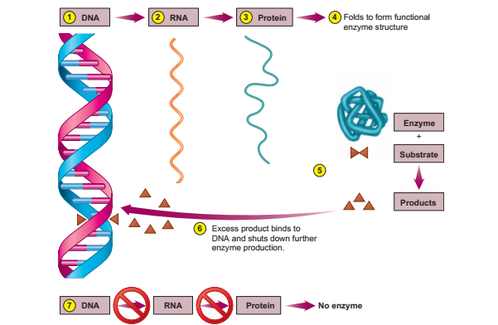
Figure 2.10 One type of genetic control of enzyme synthesis: enzyme repression. (1), (2), (3), (4), (5), The enzyme is synthesized continuously via uninhibited transcription and translation until enough product has been made. (6), (7), Excess product reacts with a site on DNA that regulates the enyzme’s synthesis, thereby inhibiting further enzyme production.

Slide 13
THANK YOU

